Slide 1
Basic Cryptography
HNDIT2301: Operating System and Information Security
Week – 2

Slide 2
Block Cipher Characteristics
features seen in modern block ciphers are:
  variable key length / block size / no rounds
  mixed operators, data/key dependent rotation
  key dependent S-boxes
  more complex key scheduling
  operation of full data in each round
  varying non-linear functions

Slide 3
Blowfish
a symmetric block cipher designed by Bruce Schneier in 1993/94
characteristics
  fast implementation on 32-bit CPUs
  compact in use of memory
  simple structure eases analysis/implemention
  variable security by varying key size
has been implemented in various products

Slide 4
Stream Ciphers
process the message bit by bit (as a stream)
typically have a (pseudo) random stream key
combined (XOR) with plaintext bit by bit
randomness of stream key completely destroys any statistically properties in the message
  C_{i} = M_{i} XOR StreamKey_{i}
what could be simpler!!!!
but must never reuse stream key
  otherwise can remove effect and recover messages

Slide 5
Stream Cipher Properties
some design considerations are:
  long period with no repetitions
  statistically random
  depends on large enough key
  large linear complexity
  correlation immunity
  confusion
  diffusion
  use of highly non-linear boolean functions

Slide 6
RC4
a proprietary cipher owned by RSA DSI
another Ron Rivest design, simple but effective
variable key size, byte-oriented stream cipher
widely used (web SSL/TLS, wireless WEP)

Slide 7
RC4 – contd.
key forms random permutation of all 8-bit values
uses that permutation to scramble input info processed a byte at a time

Slide 8
Block vs Stream Ciphers
block ciphers process messages in into blocks, each of which is then en/decrypted
like a substitution on very big characters
  64-bits or more
stream ciphers process messages a bit or byte at a time when en/decrypting
many current ciphers are block ciphers
hence are focus of course

Slide 9
Steganography
an alternative to encryption
hides existence of message
  using only a subset of letters/words in a longer message marked in some way
  using invisible ink
  hiding in LSB in graphic image or sound file
has drawbacks
  high overhead to hide relatively few info bits

Slide 10
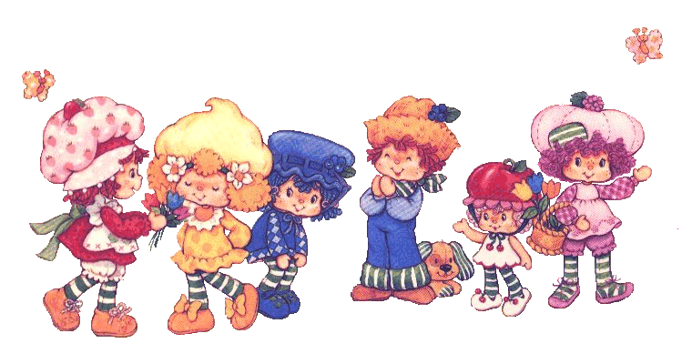
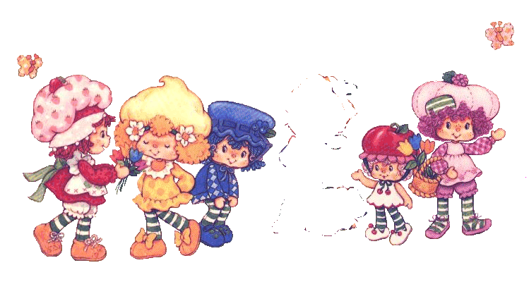
2 | 6 | 5
7 | 7 | 9
o | 4 | 4
5 | 1 | 8
Original Image
Encoded using Steganography tools
2 | 6 | 4
7 | 5 | 4
2 | 4 | 3
5 | 1 | 8
Ciphered Image

Slide 11
Summary
have considered:
  classical cipher techniques and terminology
  Mono alphabetic substitution ciphers
  cryptanalysis using letter frequencies
  transposition ciphers
  product ciphers and rotor machines
  Block and stream ciphers
  stenography

